Slide 1
CSIT988/CSIT488 Security, Ethics and Professionalism Week 7: Developing the security program

Slide 2
Introduction
Some organizations use security program to describe the entire set of personnel, plans, policies, and initiatives related to information security
The term “information security program” is used here to describe the structure and organization of the effort that contains risks to the information assets of the organization

Slide 3
Organizing for Security
Variables involved in structuring an information security program
Organizational culture
Size
Security personnel budget
Security capital budget
As organizations increase in size:
Their security departments are not keeping up with increasingly complex organizational infrastructures

Slide 4
Organizing for Security (cont’d.)
Information security departments tend to form internal groups
To meet long-term challenges and handle day-to-day security operations
Functions are likely to be split into groups
Smaller organizations typically create fewer groups
Perhaps having only one general group of specialists

Slide 5
Organizing for Security (cont’d.)
Very large organizations
More than 10,000 computers
Security budgets often grow faster than IT budgets
Even with a large budgets, the average amount spent on security per user is still smaller than any other type of organization
Small organizations spend more than $5,000 per user on security; very large organizations spend about 1/18th of that, roughly $300 per user
Does a better job in the policy and resource management areas
Only 1/3 of organizations handled incidents according to an IR plan

Slide 6
Organizing for Security (cont’d.)
Large organizations
Have 1,000 to 10,000 computers
Security approach has often matured, integrating planning and policy into the organization’s culture
Do not always put large amounts of resources into security
Considering the vast numbers of computers and users often involved
They tend to spend proportionally less on security

Slide 7
Security in Medium-Sized Organizations
Medium-sized organizations
Have between 100 and 1000 computers
Have a smaller total budget
Have same sized security staff as the small organization, but a larger need
Must rely on help from IT staff for plans and practices
Ability to set policy, handle incidents, and effectively allocate resources is worse than any other size
May be large enough to implement a multi-tiered approach to security
With fewer dedicated groups and more functions assigned to each group
Tend to ignore some security functions

Slide 8
Security in Small Organizations
Small organizations
Have between 10 and 100 computers
Have a simple, centralized IT organizational model
Spend disproportionately more on security
Information security is often the responsibility of a single security administrator
Have little in the way of formal policy, planning, or security measures
Commonly outsource their Web presence or electronic commerce operations
Security training and awareness is commonly conducted on a 1-on-1 basis
Policies (when they exist) are often issue-specific
Formal planning is often part of IT planning
Threats from insiders are less likely
Every employee knows every other employee

Slide 9
Security in Large Organizations
One approach separates functions into four areas:
Functions performed by non-technology business units outside of IT (legal, training)
Functions performed by IT groups outside of information security area (systems and network security administrations)
Functions performed within information security department as customer service (risk and vulnerability assessments, system testing, IR, planning)
Functions performed within the information security department as compliance (policy)

Slide 10
Security in Large Organizations (cont’d.)
The CISO has responsibility for information security functions
Should be adequately performed somewhere within the organization
The deployment of full-time security personnel depends on:
Sensitivity of the information to be protected
Industry regulations
General profitability
The more money the company can dedicate to its personnel budget
The more likely it is to maintain a large information security staff

Slide 11
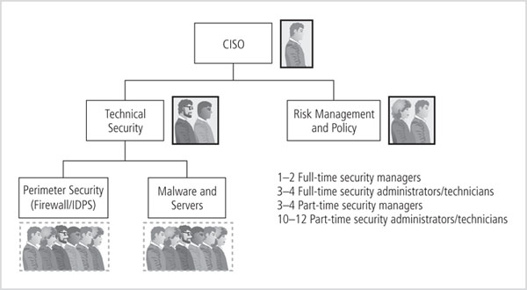
Security in Large Organizations (cont’d.)

Slide 12
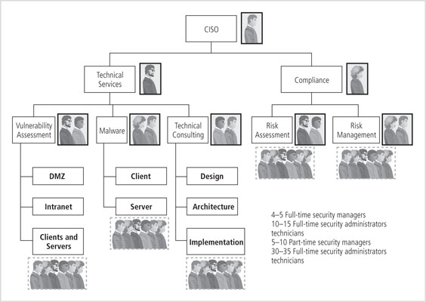
Security in Very Large Organizations (cont’d.)

Slide 13
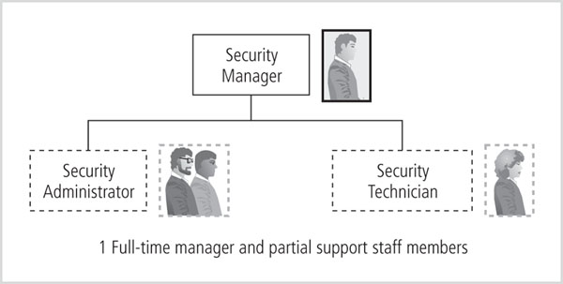
Security in Medium-Sized Organizations (cont’d.)
Figure 5-3 Example of information security staffing in a medium-sized organization

Slide 14
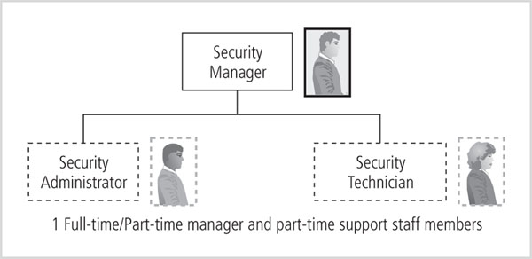
Security in Small Organizations (cont’d.)
Figure 5-4 Example of information security staffing in a smaller organization

Slide 15
Placing Information Security Within An Organization
In large organizations
InfoSec is often located within the information technology department
Headed by the CISO who reports directly to the top computing executive, or CIO
An InfoSec program is sometimes at odds with the goals and objectives of the IT department as a whole

Slide 16
Placing Information Security Within An Organization (cont’d.)
Because the goals and objectives of the CIO and the CISO may come in conflict
It is not difficult to understand the current movement to separate information security from the IT division
The challenge is to design a reporting structure for the InfoSec program that balances the needs of each of the communities of interest

Slide 17
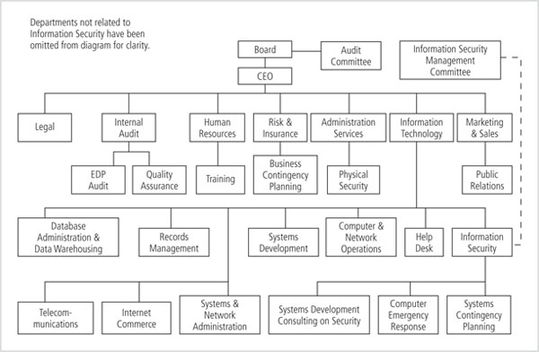
Placing Information Security Within an Organization (cont’d.)

Slide 18
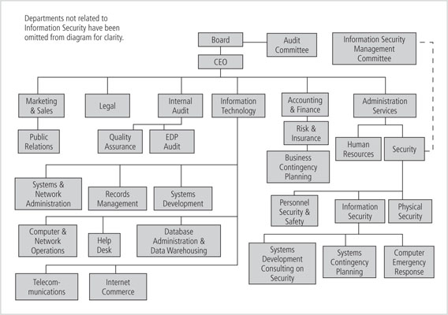
Placing Information Security Within an Organization (cont’d.)

Slide 19
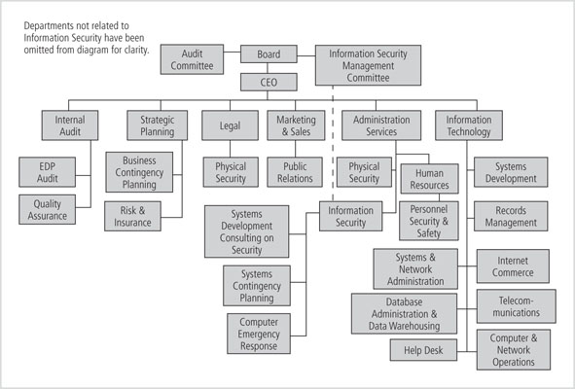
Placing Information Security Within an Organization (cont’d.)

Slide 20
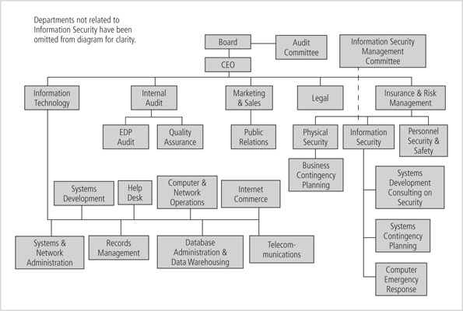
Placing Information Security Within an Organization (cont’d.)

Slide 21
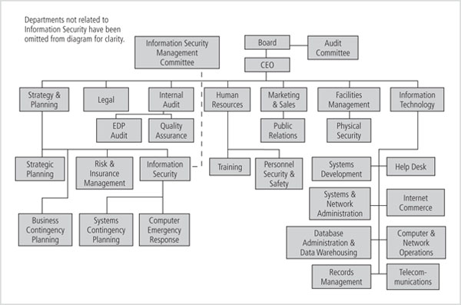
Placing Information Security Within an Organization (cont’d.)

Slide 22
Placing Information Security Within an Organization (cont’d.)
Other options
Option 6: Legal
Option 7: Internal audit (not advised)
Option 8: Help desk (not advised)
Option 9: Accounting and finance through IT (not advised)
Option 10: Human resources (not advised)
Option 11: Facilities management
Option 12: Operations

Slide 23
Components of the Security Program
Organization’s information security needs
Unique to the culture, size, and budget of the organization
Determining what level the information security program operates on depends on the organization’s strategic plan
Also the plan’s vision and mission statements
The CIO and CISO should use these two documents to formulate the mission statement for the information security program (Generally Accepted Principles and Practices for Securing Information Technology Systems, An introduction to Computer Security: the NIST Handbook)

Slide 24
Information Security Roles and Titles
Types of information security positions
Those that define
Provide the policies, guidelines, and standards
Do the consulting and the risk assessment
Develop the product and technical architectures
Senior people with a lot of broad knowledge, but often not a lot of depth
Those that build
The real “techies” who create and install security solutions

Slide 25
Information Security Roles and Titles (cont’d.)
Types of information security positions (cont’d.)
Those that administer
Operate and administer the security tools and the security monitoring function
Continuously improve the processes
A typical organization has a number of individuals with information security responsibilities

Slide 26
Information Security Roles and Titles (cont’d.)
While the titles used may be different, most of the job functions fit into one of the following:
Chief Information Security Officer (CISO) or Chief Security Officer (CSO)
Security managers
Security administrators and analysts
Security technicians
Security staffers

Slide 27
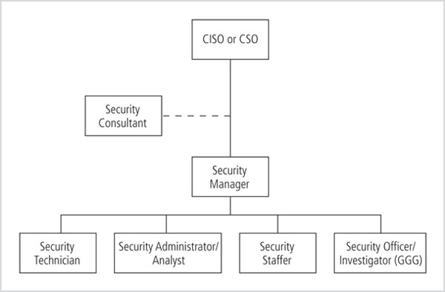
Information Security Roles and Titles (cont’d.)

Slide 28
Help Desk Personnel
Help desk
An important part of the information security team
Enhances the security team’s ability to identify potential problems
When a user calls the help desk with a complaint , the user’s problem may turn out to be related to a bigger problem, such as a hacker, denial-of-service attack, or a virus
Because help desk technicians perform a specialized role in information security, they have a need for specialized training

Slide 29
Implementing Security Education, Training, and Awareness Programs
SETA program
Designed to reduce accidental security breaches
Consists of three elements: security education, security training, and security awareness
Awareness, training, and education programs offer major benefits:
Improving employee behavior
Enabling the organization to hold employees accountable for their actions
Inform members where to report

Slide 30
Implementing SETA Programs (cont’d.)
Purpose of SETA is to enhance security:
By building in-depth knowledge, to design, implement, or operate security programs for organizations and systems
By developing skills and knowledge so that computer users can perform their jobs while using IT systems more securely
By improving awareness of the need to protect system resources

Slide 31
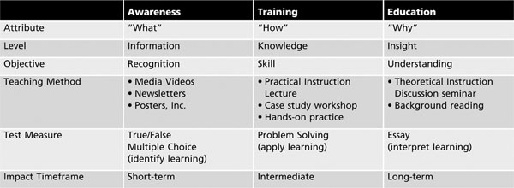
Implementing SETA Programs (cont’d.)

Slide 32
Security Education
Employees within information security may be encouraged to seek a formal education
If not prepared by their background or experience
A number of institutions of higher learning, including colleges and universities, provide formal coursework in information security

Slide 33
Security Education (cont’d.)
A knowledge map
Can help potential students assess information security programs
Identifies the skills and knowledge clusters obtained by the program’s graduates
Creating the map can be difficult because many academics are unaware of the numerous subdisciplines within the field of information security
Each of which may have different knowledge requirements

Slide 34
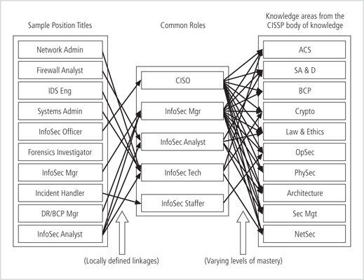
Security Education (cont’d.)
Figure 5-11 Information security knowledge map

Slide 35
Security Education (cont’d.)
Depth of knowledge
Indicated by a level of mastery using an established taxonomy of learning objectives or a simple scale such as “understanding → accomplishment → proficiency → mastery.”
Because many institutions have no frame of reference for which skills and knowledge are required for a particular job area
They may refer to the certifications offered in that field

Slide 36
Security Education (cont’d.)
Once the knowledge areas are identified, common knowledge areas are aggregated into teaching domains
From which individual courses can be created
Course design
Should enable a student to obtain the required knowledge and skills upon completion of the program
Identify the prerequisite knowledge for each class

Slide 37
Security Training
Involves providing detailed information and hands-on instruction
To develop user skills to perform their duties securely
Management can either develop customized training or outsource

Slide 38
Security Training (cont’d.)
Customizing training for users
By functional background
General user
Managerial user
Technical user
By skill level
Novice
Intermediate
Advanced

Slide 39
Training Techniques
Using the wrong method
Can hinder the transfer of knowledge
Leading to unnecessary expense and frustrated, poorly trained employees
Good training programs
Take advantage of the latest learning technologies and best practices

Slide 40
Training Techniques (cont’d.)
Recent developments
Less use of centralized public courses and more on-site training
Training is often for one or a few individuals
Waiting until there is a large-enough group for a class can cost companies lost productivity
Other best practices
Increased use of short, task-oriented modules
Available during the normal work week

Slide 41
Training Techniques (cont’d.)
Selection of the training delivery method
Not always based on the best outcome for the trainee
Often overridden by budget, scheduling, and needs of the organization
Types of delivery methods
One-on-one
Formal class
Computer-based training (CBT)
Distance learning/web seminars
User support group
On-the-job training
Self-study (non-computerized)

Slide 42
Training Techniques (cont’d.)
Training methods
Use a local training program
Use a continuing education department
Use another external training agency
Hire a professional trainer, a consultant, or someone from an accredited institution to conduct on-site training
Organize and conduct training in-house using organization’s own employees

Slide 43
Implementing Training
Seven-step methodology generally applies:
Step 1: Identify program scope, goals, and objectives
Step 2: Identify training staff
Step 3: Identify target audiences
Step 4: Motivate management and employees
Step 5: Administer the program
Step 6: Maintain the program
Step 7: Evaluate the program

Slide 44
Security Awareness
One of the least frequently implemented, but most effective security methods is the security awareness program
Security awareness programs:
Set the stage for training by changing organizational attitudes to realize the importance of security and the adverse consequences of its failure
Remind users of the procedures to be followed

Slide 45
Security Awareness (cont’d.)
Best practices
Focus on people
Refrain from using technical jargon
Use every available venue
Define learning objectives, state them clearly, and provide sufficient detail and coverage
Keep things light
Don’t overload the users
Help users understand their roles in InfoSec
Take advantage of in-house communications media
Make the awareness program formal
Plan and document all actions
Provide good information early, rather than perfect information late

Slide 46
Security Awareness (cont’d.)
The ten commandments of information security awareness training
Information security is a people, rather than a technical, issue
If you want them to understand, speak their language
If they cannot see it, they will not learn it
Make your point so that you can identify it and so can they.
Never lose your sense of humor

Slide 47
Security Awareness (cont’d.)
The ten commandments of information security awareness training (cont’d.)
Make your point, support it, and conclude it
Always let the recipients know how the behavior that you request will affect them
Ride the tame horses (keep information in people’s minds)
Formalize your training methodology
Always be timely, even if it means slipping schedules to include urgent information

Slide 48
Security Awareness (cont’d.)
Many security awareness components are available at little or no cost
Videos
Posters and banners
Lectures and conferences
Computer-based training
Newsletters
Brochures and flyers
Trinkets (coffee cups, pens, pencils, T-shirts)
Bulletin boards
Web site
conference

